Slide 1

Introduction To Machine Learning
@geekwhocodes

Slide 2


Ganesh Raskar
Cloud Consultant at RapidCircle India
Periodic Blogger (http://geekwhocodes.me)
Lifelong learner
https://about.me/geekwhocodes
https://www.linkedin.com/in/geekwhocodes

Slide 3
Agenda
1
Introduction
2
Terminology
3
Machine Learning Workflow
4
Categories or Types
5
Demo
Notes:
Joke and start

Slide 4
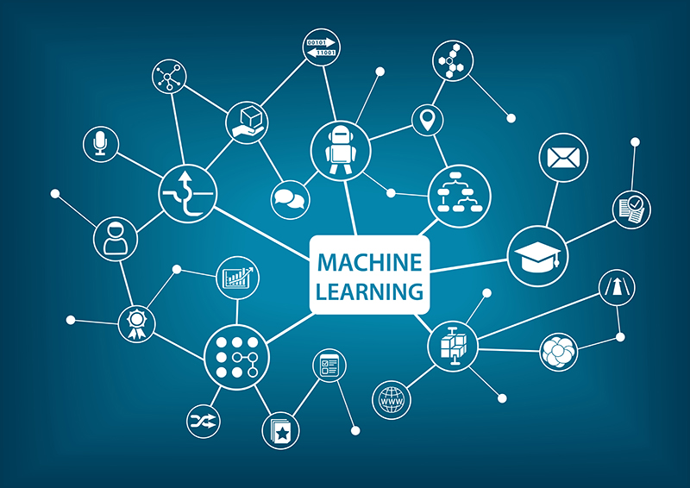
1
Introduction
Machine learning is a field of computer science that gives computers the ability to learn without being explicitly programmed
Subfield of AI
Building blocks to make computers learn to respond/behave more intelligently
There are various techniques and implementations
It’s an iterative process
Notes:
Ask ML defn.
Subfield of AI:
What is AI ?
Agent/computer which to become aware of its environment/domain and takes actions to maximize it’ chance at some goal/task
Agent that mimic or try to mimic the cognitive functions. Like ‘learning’ , ‘problem solving’ etc
Examples:
Virtual Personal Assistants
Video Games (Dota, CS)
Self Driving Cars
Online Customer Support
Creating music
Drawing
ML can be fail
https://blogs.microsoft.com/blog/2016/03/25/learning-tays-introduction/

Slide 5
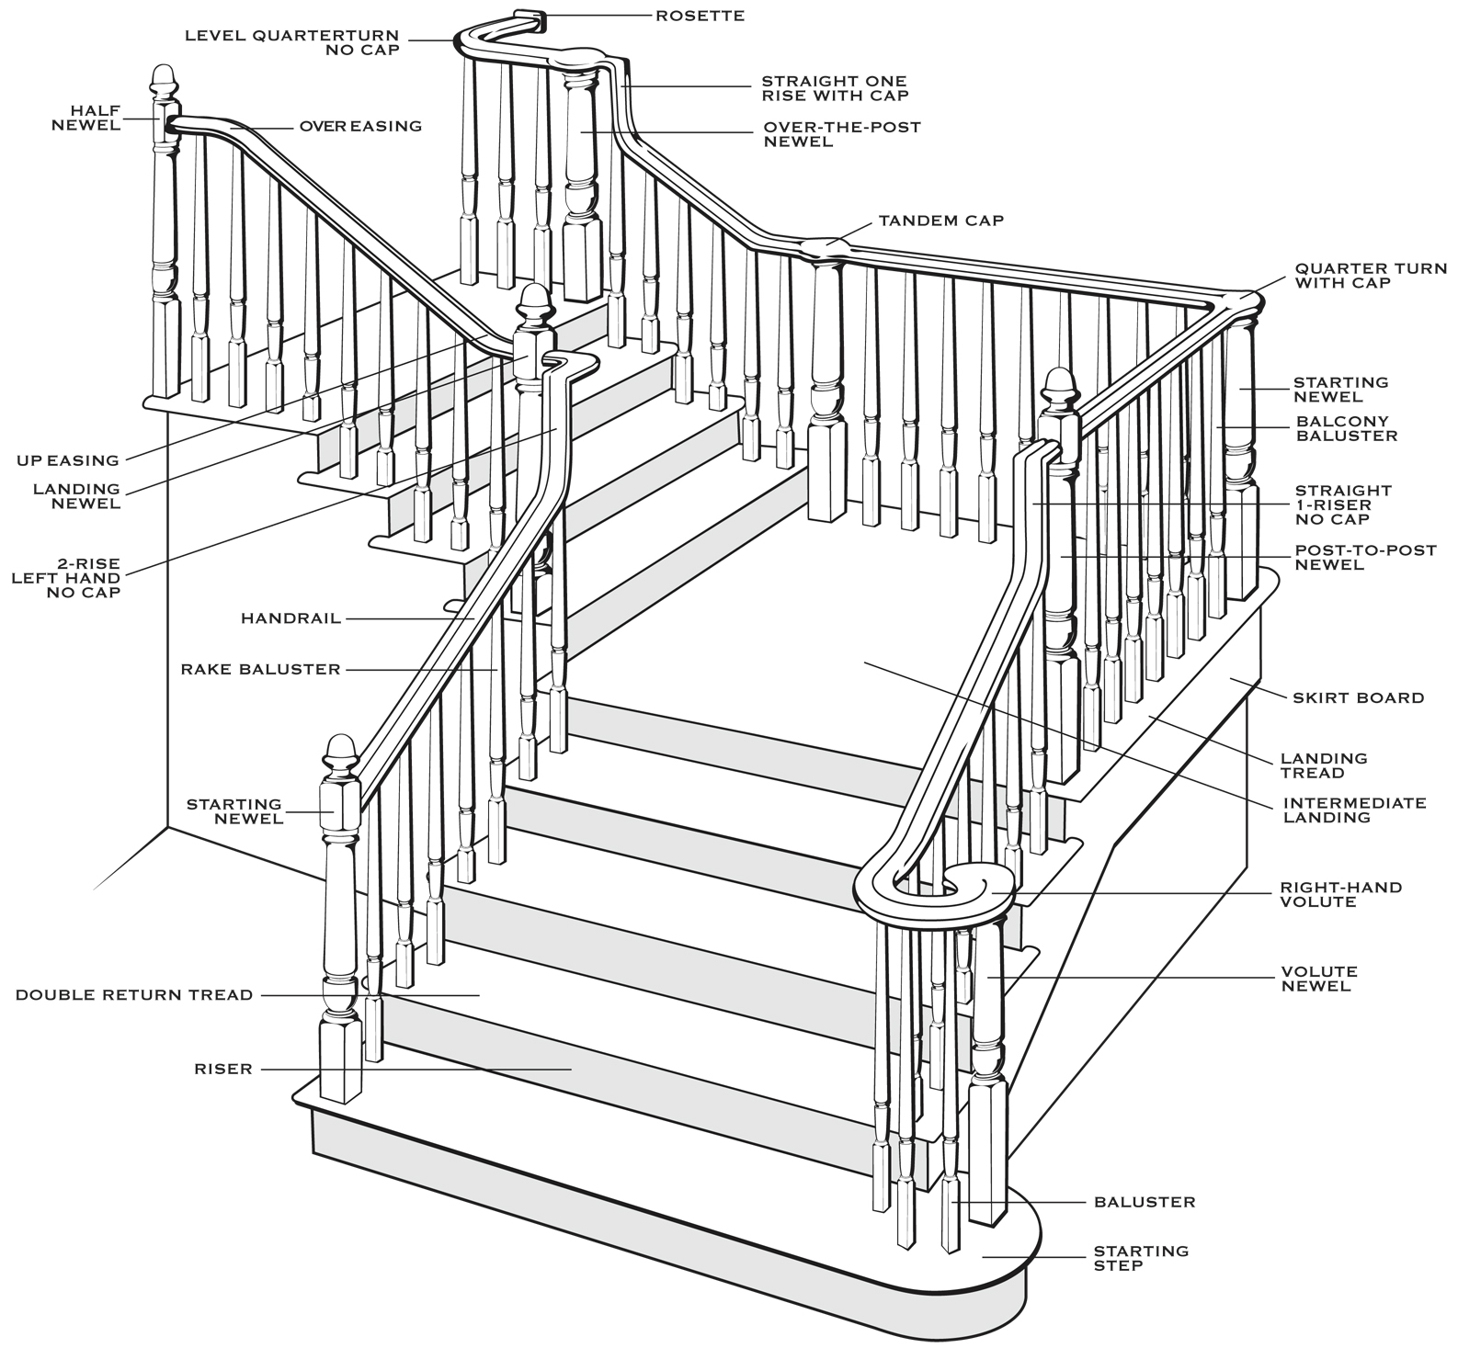
2
Terminology
Training, Testing Sets
Features
Feature Extraction
Evaluation
Deploy
Notes:
What is Datasets:
What are train, dev, test sets
Why
What is Feature:
Information to take some action or perform some action
What is Feature Extraction:
Method to extract, generate that information from dataset
What is evaluation:
Why?
Deploy:
Omkar and Sanket will give you demo of deployed model and how to use it

Slide 6
Terminology
Dataset
5 | 90% | 1 | 1
1 example
#Hours Study | Attendance (%) | Last Year Passed? | Pass?
5 | 90% | 1 | 1
1 | 20% | 0 | 0
2 | 70% | 1 | 0
10 | 99% | 1 | 0
3 | 65% | 1 | 1
1 | 50% | 1 | 0
6 | 78% | 1 | 1
… | … | …. | ….
…. | …. | …… | ……...
Train Set
Large slice of our dataset (90%)
Testing Set
Remaining slice of our dataset (10%)
Feature extraction
Extracting relevant information to predict the label
Example :
Students Name, Mobile Number doesn't matter to predict the label in give dataset.
Evaluation
Deploy
1000
Truth Values/Labels

Slide 7
3
Machine Learning Workflow
Machine Learning in a Nutshell
ML Workflow in Depth
It’s Iterative
Notes:
What is Datasets:
What are train, dev, test sets
Why
What is Feature:
Information to take some action or perform some action
What is Feature Extraction:
Method to extract, generate that information from dataset
What is evaluation:
Why?
Deploy:
Omkar and Sanket will give you demo of deployed model and how to use it

Slide 8



Machine Learning in a Nutshell
Contains
patterns
Finds
patterns
Recognizes patterns
 | Data
Machine learning algorithm
Model
Supplies new data to see if it matches known patterns
Application
Notes:
Look at our small dataset, it clearly contains pattern
We feed it to learning algorithm
Get prediction

Slide 9













Machine Learning Workflow in Depth
Choose
data
Iterate until data is ready
Iterate to find the best model
Raw Data
Apply learning algorithm to data
Deploy chosen model
Apply pre- processing to data
Candidate Model
Chosen Model
Prepared Data
Raw
Data
Data
Applications
Processing Modules
ML Algorithms
Notes:
If we consider data of student:
Our dataset with Name, DoB, Address etc
We need to clean it
Need to extract features
Then it become eligible to feed to ML algorithm

Slide 10











It’s Iterative
Re-create model regularly
Apply pre- processing to data
Apply learning algorithm to data
Deploy chosen model
Raw Data
Prepared Data
Candidate Model
Chosen Model

Slide 11
4
Categories or Types
Supervised
Unsupervised
Reinforcement
Let’s categorize ML problems
Notes:
What is Supervised:
Try to learn from truth values provided by humans or from reliable source
Unsupervised
Try to learn from unlabelled data
Try to find patterns and categories
Reinforcement learning :
Agent forced to take action in an environment so as to maximize some notion of cumulative reward.
Like giving a bribe kinda thing.
I’m pretty new to RL, so can’t talk much about it

Slide 12
Categorizing Machine Learning Problems
Regression
Classification
For Predicting real-valued outcomes :
How many customers will visit our site next week?
How may TV’s will sell next year?
Can we predicts someone’s income from their click
through information?
How many? It’s regression problem
For predicting truth valued outcomes:
Will I pass next semester ?
Is this transaction is fraudulent ?
Is this a spam e-mail?
Clustering
Recommenders
For solving Unsupervised learning problems :
Identifying chair from bunch of different objects?
Hand-writing recognition
Is this Ganesh's voice ?
Recommending products based on history:
Building recommender engines

Slide 13
5
z
Demo
Cat or !Cat
Let’s teach computer how to identify given image is Cat or !Cat
Notes:
Fire up Azure Notebooks

Slide 14

6
Q&A, Resource
https://www.coursera.org/learn/machine-learning
https://medium.com/machine-learning-for-humans/how-to-learn-machine-learning-24d53bb64aa1
https://github.com/ujjwalkarn/Machine-Learning-Tutorials
Notes:
Q&A

Slide 15
Thank you ☺
Find this presentation at:
https://github.com/geekwhocodes/MLHandsOn
*source of images: various search engines
*I don’t own some images used in this presentation

